Slide 1
Employee Payroll Management System
By Gopalakrishnan Kumar, MTech IIT-Bombay
Freelance Data Science Consultant, GLV Data Solutions Consultancy
LinkedIn: Profile Link : https://www.linkedin.com/in/gopalakrishnankumar-a73301110/
Github:
https://www.github.com/Gopalakrishnan-Kumar/
Kaggle: https://www.kaggle.com/gopalkk1

Slide 2
Google Colab URL
https://colab.research.google.com/drive/1gqyxK7OzrFEIrf9LHmOdBYSTuA3iA_sE?usp=sharing

Slide 3
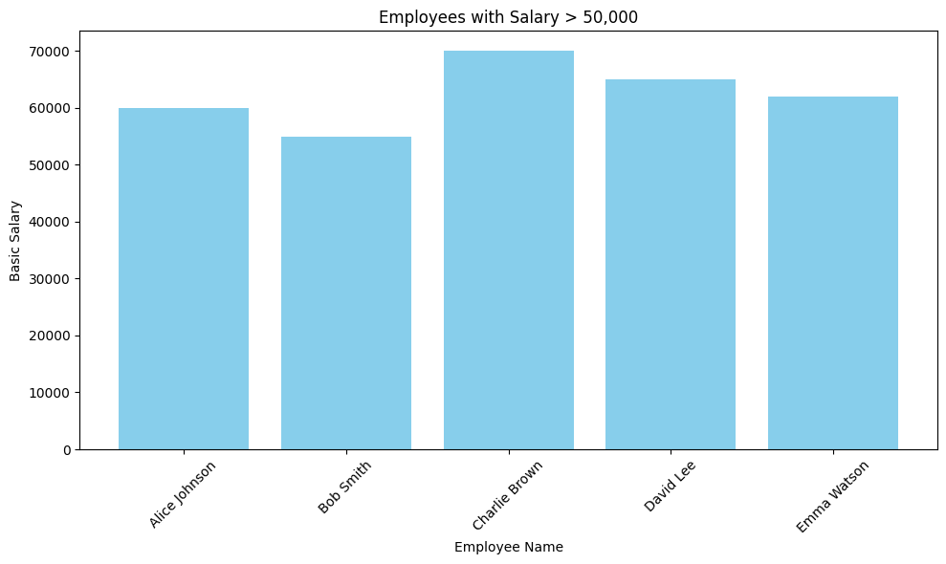
Bar Plot

Slide 4
Conclusion
The results were successfully analyzed.

